Slide 1
My 3RD year university portfolio
File created on: 9/6/2024 4:05:11 PM

Slide 2
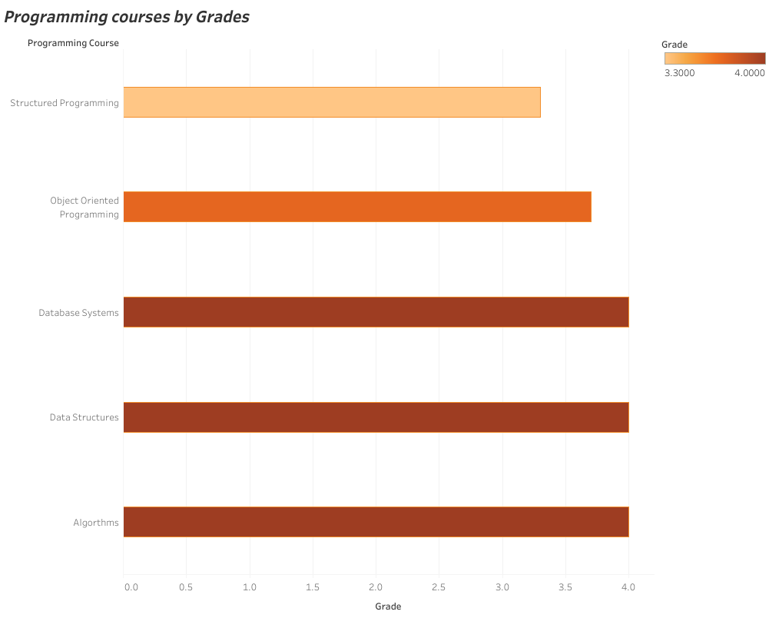

Slide 3
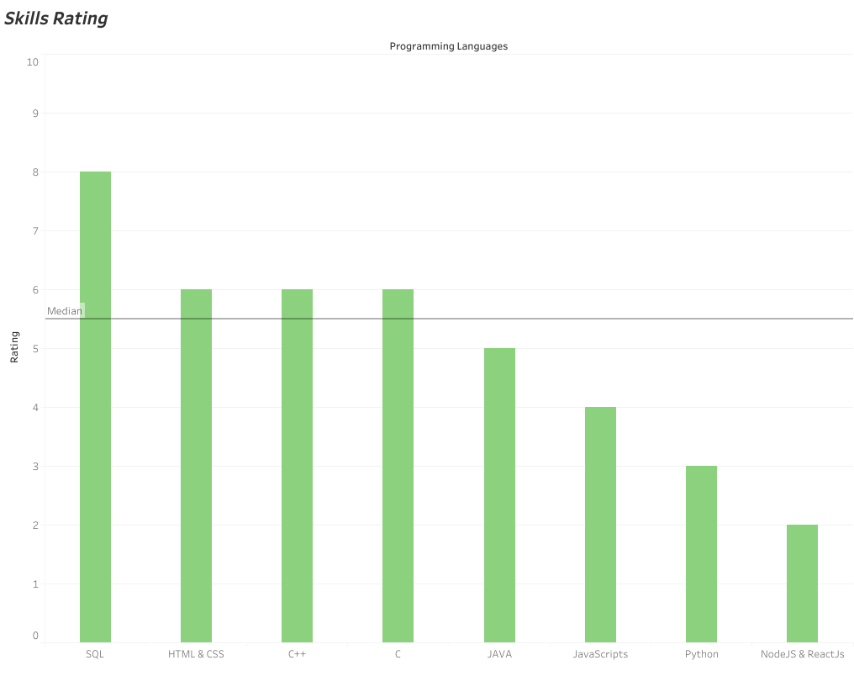

Slide 4
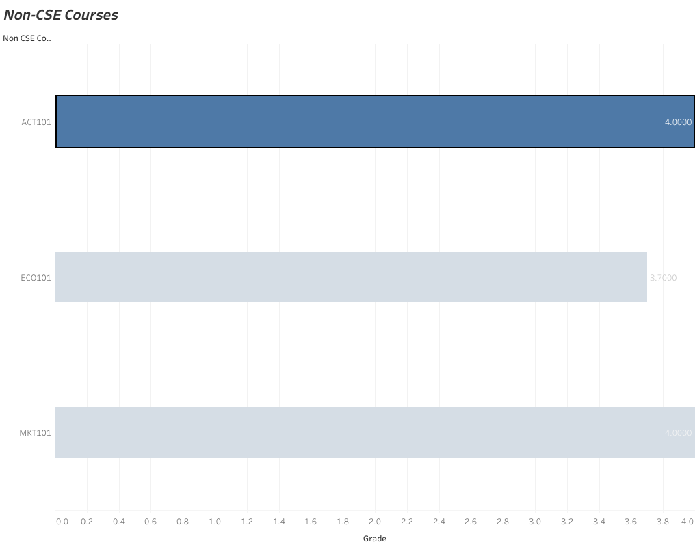

Slide 5
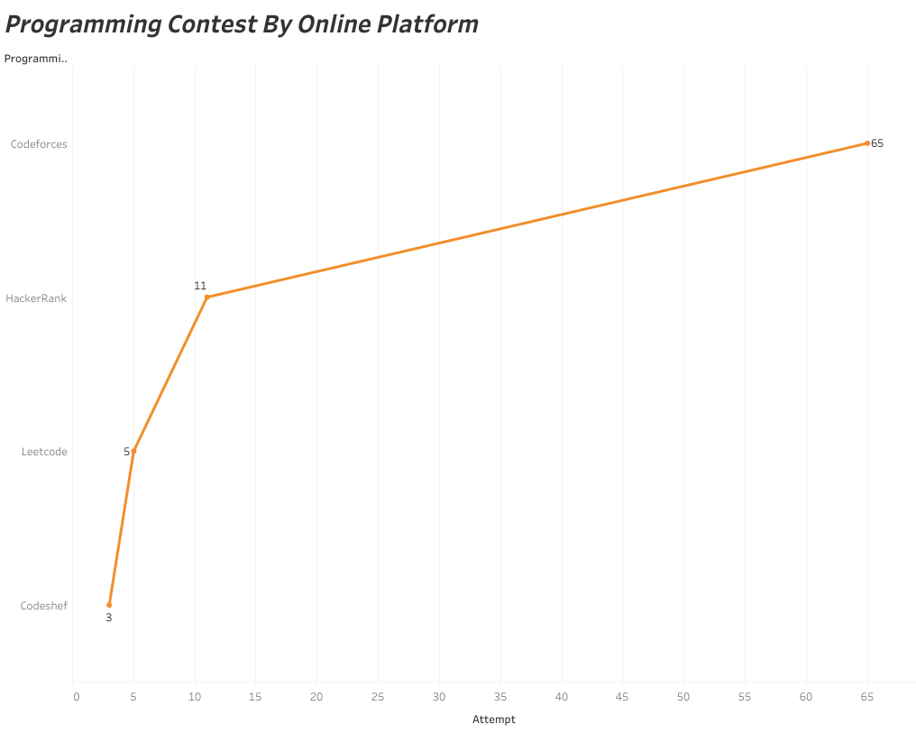

Slide 6
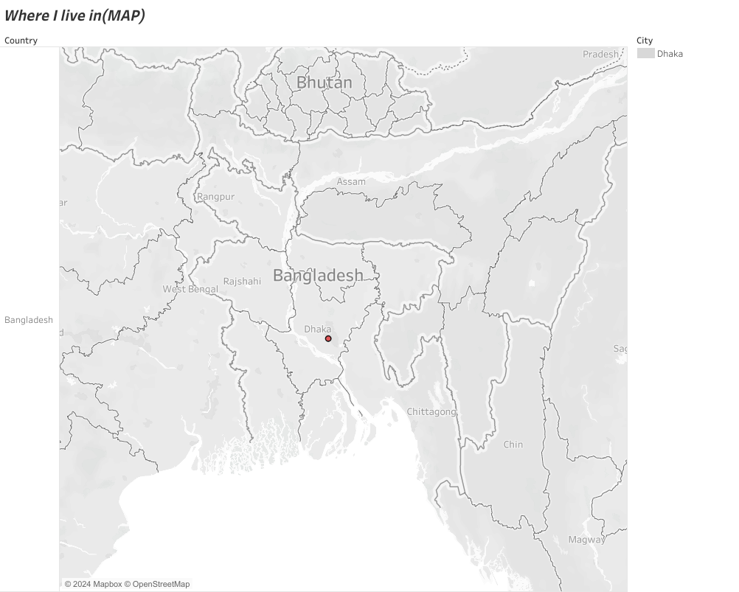

Slide 7
